Slide 1
Chapter 3：STATIC GAMES OF COMPLETE INFORMATION: Preliminaries

Slide 2

In essence, you and your peers are engaged in a strategic environment in which you have to think hard about what other players are doing in order to decide what is best for you—knowing that the other players are going through the same difficulties.
博弈论与信息经济学
北京航空航天大学经济管理学院 崔志伟

Slide 3

We will start with static games of complete information, which are the most fundamental games, or environments, in which such strategic considerations can be analyzed.
A static game is similar to the very simple decision problems in which a player makes a once-and-for-all decision, after which outcomes are realized.
In a static game, a set of players independently choose once-and-for-all actions, which in turn cause the realization of an outcome.
博弈论与信息经济学
北京航空航天大学经济管理学院 崔志伟

Slide 4
A static game can be thought of as having two distinct steps
Step 1: Each player simultaneously and independently chooses an action.
By simultaneously and independently, we mean a condition broader and more accommodating than players all choosing their actions at the exact same moment. We mean that players must take their actions without observing what actions their counterparts take and without interacting with other players to coordinate their actions.
Step 2: Conditional on the players’ choices of actions, payoffs are distributed to each player.
That is, once the players have all made their choices, these choices will result in a particular outcome, or probabilistic distribution over outcomes. The players have preferences over the outcomes of the game given by some payoff function over outcomes.
博弈论与信息经济学
北京航空航天大学经济管理学院 崔志伟

Slide 5
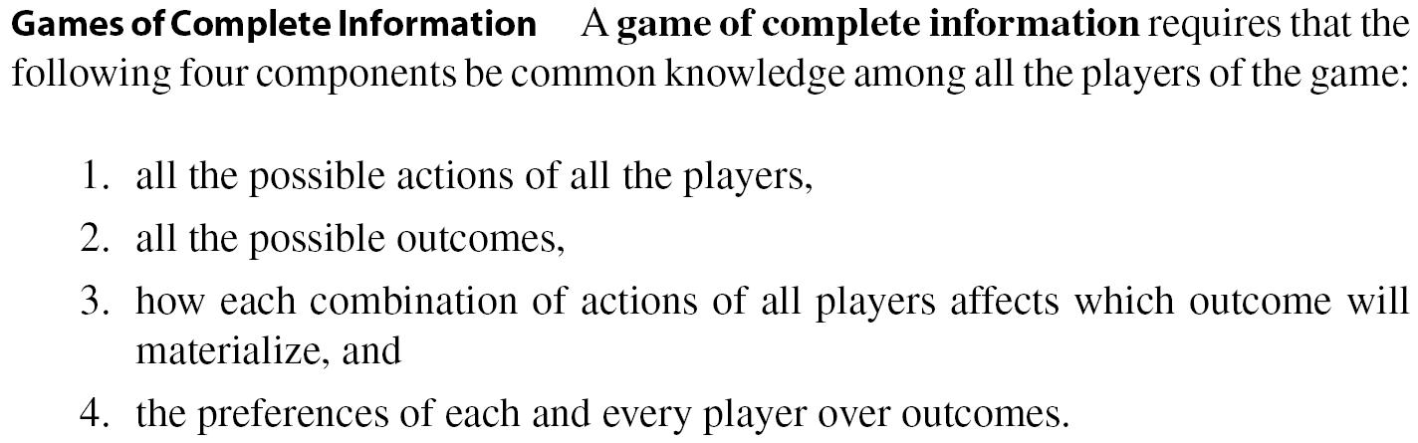
Steps 1 and 2 settle what we mean by static. What do we mean by complete information? The loose meaning is that all players understand the environment they are in—that is, the game they are playing—in every way.
博弈论与信息经济学
北京航空航天大学经济管理学院 崔志伟

Slide 6
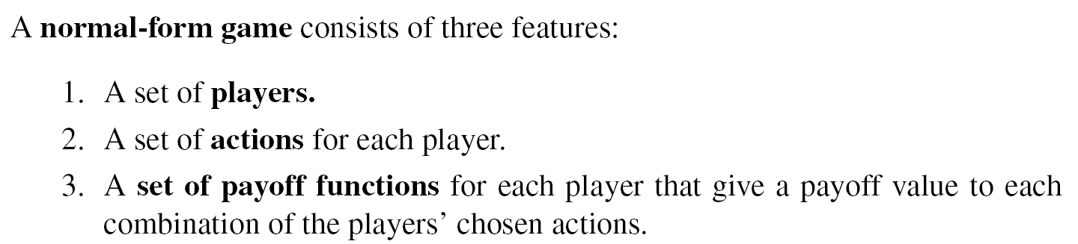
3.1 Normal-Form Games with Pure Strategies
This definition is similar to that of the single-person decision problem, but here we incorporate the fact that many players are interacting. Each has a set of possible actions, the combination (profile) of actions that the players choose will result in an outcome, and each has a payoff from the resulting outcome.
博弈论与信息经济学
北京航空航天大学经济管理学院 崔志伟

Slide 7
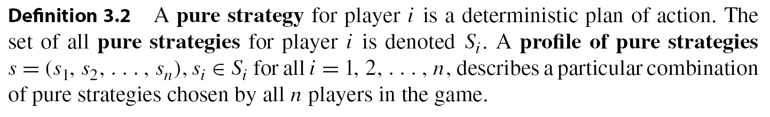
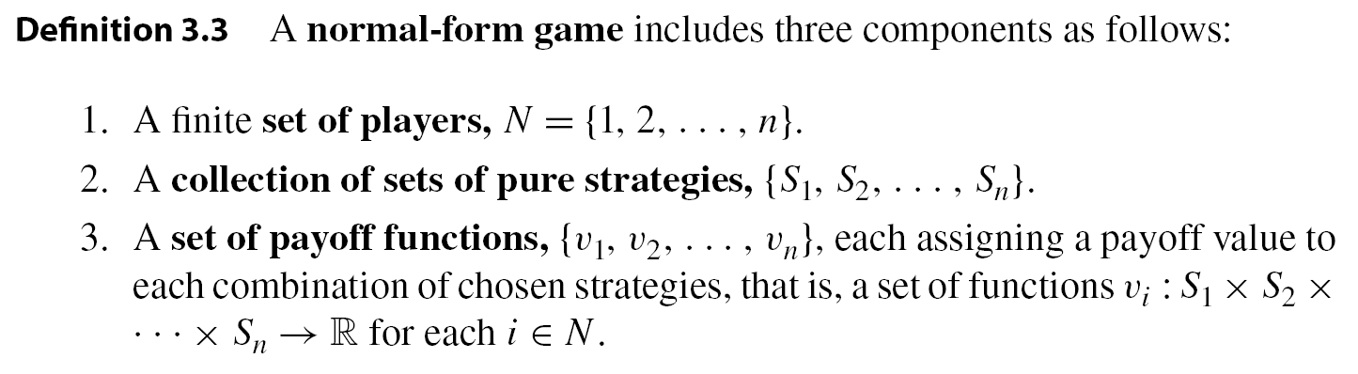
The normal-form game will be a triple of sets (N, {S_{i}}_{i∈N}, {v_{i}}_{i∈N} ) , where N is the set of players, {S_{i}}_{i∈N} is the set of all players’ strategy sets, and {v_{i}}_{i∈N} is the set of all players’ payoff functions over the strategy profiles of all the players.
博弈论与信息经济学
北京航空航天大学经济管理学院 崔志伟

Slide 8

3.1.1 Example: The Prisoner’s Dilemma
博弈论与信息经济学
北京航空航天大学经济管理学院 崔志伟

Slide 9
3.1.1 Example: The Prisoner’s Dilemma
It is a static game of complete information that represents a situation consisting of two individuals (the players) who are suspects in a serious crime, say, armed robbery. The police have evidence of only petty theft, and to nail the suspects for the armed robbery they need testimony from at least one of the suspects.
The police separate the two suspects at the police station and question each in a different room. Each suspect is offered a deal that reduces the sentence he will get if he confesses, or “finks” (F), on his partner in crime. The alternative is for the suspect to say nothing to the investigators, or remain “mum” (M), so that they do not get the incriminating testimony from him.
博弈论与信息经济学
北京航空航天大学经济管理学院 崔志伟

Slide 10
The payoff of each suspect is determined as follows: If both choose mum, then both get 2 years in prison because the evidence can support only the charge of petty theft. If, say, player 1 mums while player 2 finks, then player 1 gets 5 years in prison while player 2 gets only 1 year in prison for being the sole cooperator. The reverse outcome occurs if player 1 finks while player 2 mums. Finally, if both fink then both get only 4 years in prison.
Because it is reasonable to assume that more time in prison is worse, we use the payoff representation that equates each year in prison with a value of −1.
博弈论与信息经济学
北京航空航天大学经济管理学院 崔志伟

Slide 11
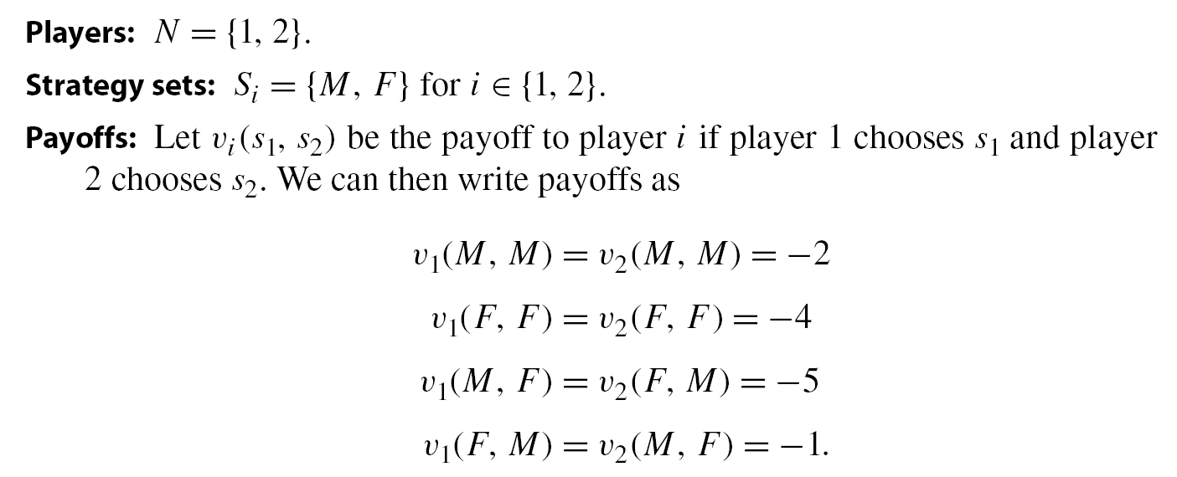
博弈论与信息经济学
北京航空航天大学经济管理学院 崔志伟

Slide 12
3.1.3 Example: Voting on a New Agenda
Consider three players on a committee who have to vote on whether to remain at the status quo or adopt a new policy. For example, three housemates currently have an agreement under which they clean the house once every two weeks (the status quo) and they are considering cleaning it every week (the new policy). The members of the board of a firm who have to vote on changing the CEO’s compensation, or a committee of legislators who must vote on whether to adopt new regulations.
Each can vote “yes” (Y ), “no” (N), or “abstain” (A). We can set the payoff from the status quo to be 0 for each player. Players 1 and 2 prefer the new policy, so let their payoff value for it be 1, while player 3 dislikes the new policy, so let his payoff from it be −1. Assume that the choice is made by majority voting as follows: if there is no majority of Y over N then the status quo prevails; otherwise the majority is decisive.
博弈论与信息经济学
北京航空航天大学经济管理学院 崔志伟

Slide 13
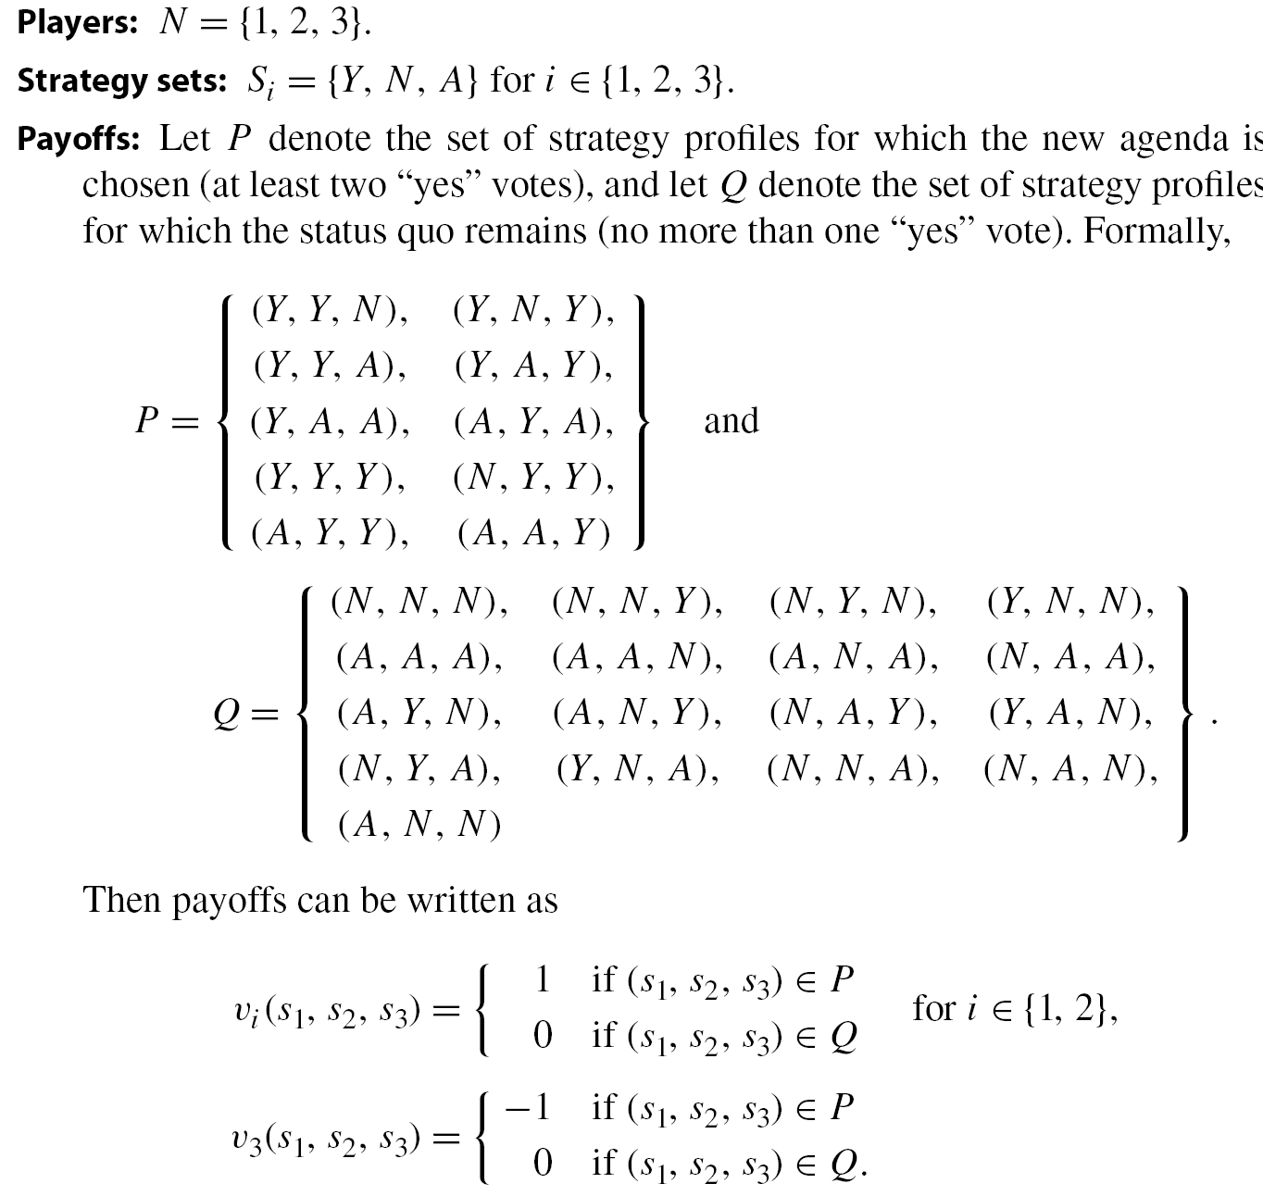
博弈论与信息经济学
北京航空航天大学经济管理学院 崔志伟

Slide 14
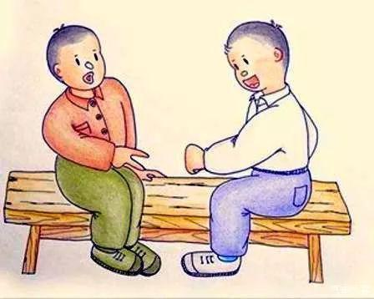
3.1.S Example: Rock-paper-scissors
博弈论与信息经济学
北京航空航天大学经济管理学院 崔志伟

Slide 15
Players: N = {1, 2}.
Strategy sets: S_{i} = {R, P, S} for i ∈ {1, 2}.
Payoffs: Let v_{i}(s₁, s₂) be the payoff to player i if player 1 chooses s₁ and player 2 chooses s₂. We can write payoffs as
v_{i}(R, R)= v_{i}(P, P)= v_{i}(S, S) =0 for i ∈ {1, 2}
v₁(R, P)= -v₂(R, P)=-1
v₁(R, S)= -v₂(R, S)=1
v₁(P, R)= -v₂(P, R)=1
v₁(P, S)= -v₂(P, S)=-1
v₁(S, R)= -v₂(S, R)=-1
v₁(S, P)= -v₂(S, P)=1
博弈论与信息经济学
北京航空航天大学经济管理学院 崔志伟

Slide 16
有一对情侣，他们高中相识，彼此相爱，大学去了美国，那个城市有一个杀人狂，专杀恋人，他们成为了杀人狂的牺牲品，他们被装在机器上，一分钟腰部的刀会撕裂腹部，生还的办法是一个剪刀石头布的游戏，胜方生存，他们决定共同出石头一起死，可是女孩死了，因为他出了剪刀，女孩出了布。
第一个：男孩为了救女孩决定自我牺牲，出了剪刀。女孩自私，使坏，一开始就谋划出布，结果害人不成，自己死了，活该。
第二个：男孩为了救女孩决定自我牺牲，出了剪刀。女孩凭着对男孩的了解，知道他一定会出剪刀，所以她出了布。这是一对相爱的恋人运用博弈论，想方设法要牺牲自己、让爱人活下来的故事。
第三个：女孩为了活命，出了布；男孩知道女孩一定会出布，所以男孩出了剪刀。
博弈论与信息经济学
北京航空航天大学经济管理学院 崔志伟

Slide 17
3.2 Matrix Representation: Two-Player Finite Game
For two-person games in which each player has a finite number of strategies, there is a convenient representation that is easy to read.
博弈论与信息经济学
北京航空航天大学经济管理学院 崔志伟

Slide 18
Any two-player finite game can be represented by a matrix that will capture all the relevant information of the normal-form game. This is done as follows:
Rows Each row represents one of player 1’s strategies. If there are k strategies in S₁ then the matrix will have k rows.
Columns Each column represents one of player 2’s strategies. If there are m strategies in S₂ then the matrix will have m columns.
Matrix entries Each entry in this matrix contains a two-element vector (v₁, v₂), where v_{i} is player i’s payoff when the actions of both players correspond to the row and column of that entry.
博弈论与信息经济学
北京航空航天大学经济管理学院 崔志伟

Slide 19
3.1.1 Example: The Prisoner’s Dilemma
Player 2
M
F
M
-2, -2 | -5, -1
-1, -5 | -4, -4
Player 1
F
博弈论与信息经济学
北京航空航天大学经济管理学院 崔志伟

Slide 20
3.1.1 Example: Rock-Paper-Scissors
Player 2
R
P
S
R
0, 0 | -1, 1 | 1, -1
1, -1 | 0, 0 | -1, 1
-1, 1 | 1, -1 | 0, 0
Player 1
P
S
博弈论与信息经济学
北京航空航天大学经济管理学院 崔志伟

Slide 21
3.3 Solution Concepts
In this section we outline some criteria that will be helpful in evaluating potential methods to analyze and solve games.
As an example, consider the Prisoner’s Dilemma. Imagine that you are player 1’s lawyer, and that you wish to advise him about how to behave. The game may be represented as follows:
Player 2
M
F
M
-2, -2 | -5, -1
-1, -5 | -4, -4
Player 1
F
博弈论与信息经济学
北京航空航天大学经济管理学院 崔志伟

Slide 22
This is the “dilemma”: each player is better off playing F regardless of his opponent’s actions, but this leads the players to receive payoffs of −4 each, while if they could only agree to both choose M, then they would obtain −2 each.
博弈论与信息经济学
北京航空航天大学经济管理学院 崔志伟

Slide 23
You might want to say that they are friends, having stolen together for some time now, and therefore that they care for one another. In this case one of our assumptions is incorrect: the payoffs in the matrix may not represent their true payoffs, and if taken into consideration, altruism would lead both players to choose M instead of F.
For example, to capture the idea of altruism and mutual caring, assume that a year in prison for each player is worth −1 to himself and imposes −1/2 on the other player’s payoff. (You care about your friend, but not as much as you care about yourself.)
博弈论与信息经济学
北京航空航天大学经济管理学院 崔志伟

Slide 24
Player 2
M
F
M
-3, -3 | -5.5, -3.5
-3.5, -5.5 | -6, -6
Player 1
F
The altruistic game will predict cooperative behavior: regardless of what player 2 does, it is always better for player 1 to play M, and the same holds true for player 2.
博弈论与信息经济学
北京航空航天大学经济管理学院 崔志伟

Slide 25
Another classic game is the Battle of the Sexes, introduced by R. Duncan Luce and Howard Raiffa (1957) in their seminal book Games and Decisions. The story goes as follows.
Alex and Chris are a couple, and they need to choose where to meet this evening. The catch is that the choice needs to be made while each is at work, and they have no means of communicating. (There were no cell phones or email in 1957, and even landline phones were not in abundance.)
Both players prefer being together over not being together, but Alex prefers opera (O) to football (F), while Chris prefers the opposite. This implies that for each player being together at the venue of choice is better than being together at the other place, and this in turn is better than being alone. Using the payoffs of 2, 1 and 0 to represent this order, the game is summarized in the following matrix:
博弈论与信息经济学
北京航空航天大学经济管理学院 崔志伟

Slide 26
Chris
O
F
O
2, 1 | 0, 0
0, 0 | 1, 2
Alex
F
What can you recommend to each player now? Unlike the situation in the Prisoner’s Dilemma, the best action for Alex depends on what Chris will do and vice versa.
If we want to predict or prescribe actions for this game, we need to make assumptions about the behavior and the beliefs of the players. We therefore need a solution concept that will result in predictions or prescriptions.
博弈论与信息经济学
北京航空航天大学经济管理学院 崔志伟

Slide 27

A solution concept is a method of analyzing games with the objective of restricting the set of all possible outcomes to those that are more reasonable than others.
博弈论与信息经济学
北京航空航天大学经济管理学院 崔志伟

Slide 28
Consider the solution concept that prescribes that each player choose the action that is always best, regardless of what his opponents will choose.
In the Prisoner’s Dilemma, playing F is always better than playing M. Hence this solution concept will predict that in this game both players will choose F.
For the Battle of the Sexes, however, there is no strategy that is always best: playing F is best if your opponent plays F, and playing O is best if your opponent plays O. Hence for the Battle of the Sexes, this simple solution concept is not useful and offers no guidance.
博弈论与信息经济学
北京航空航天大学经济管理学院 崔志伟

Slide 29
We will use the term equilibrium for any one of the strategy profiles that emerges as one of the solution concept’s predictions.
We will often think of equilibria as the actual predictions of our theory. A more forgiving meaning would be that equilibria are the likely predictions, because our theory will often not account for all that is going on.
博弈论与信息经济学
北京航空航天大学经济管理学院 崔志伟

Slide 30
3.3.1 Assumptions and Setup
To set up the background for equilibrium analysis, it is useful to revisit the assumptions that we will be making throughout:
1. Players are “rational”: A rational player is one who chooses his action, s_{i} ∈ S_{i} , to maximize his payoff consistent with his beliefs about what is going on in the game.
2. Players are “intelligent”: An intelligent player knows everything about the game: the actions, the outcomes, and the preferences of all the players.
3. Common knowledge: The fact that players are rational and intelligent is common knowledge among the players of the game.
4. Self-enforcement: Any prediction (or equilibrium) of a solution concept must be self-enforcing.
博弈论与信息经济学
北京航空航天大学经济管理学院 崔志伟

Slide 31
The requirement that any equilibrium must be self-enforcing is at the core of our analysis and at the heart of non-cooperative game theory.
We assume that the players engage in non-cooperative behavior in the following sense: each player is in control of his own actions, and he will stick to an action only if he finds it to be in his best interest. That is, if a profile of strategies is to be an equilibrium, we will require each player to be happy with his own choice given how the others make their own choices.
博弈论与信息经济学
北京航空航天大学经济管理学院 崔志伟

Slide 32
3.3.2 Evaluating Solution Concepts
We will introduce three criteria that will help us evaluate a variety of solution concepts: existence, uniqueness, and invariance.
3.3.2.1 Existence: How Often Does It Apply?
A solution concept is valuable insofar as it applies to a wide variety of games, and not just to a small and selected family of games. That is, when we apply our solution concept to different games we require it to result in the existence of an equilibrium solution.
博弈论与信息经济学
北京航空航天大学经济管理学院 崔志伟

Slide 33
For example, consider solution concept: “Players always choose the action that they think their opponent will choose.” If this is our “theory” of behavior, then it will fail to apply to many—maybe most—strategic situations. In particular when players have different sets of actions then this theory would be unable to predict which outcomes are more likely to emerge as equilibrium outcomes.
One goal is to have a method that will be general enough to apply to many strategic situations; that is, it will prescribe a solution that will exist for most games we can think of.
博弈论与信息经济学
北京航空航天大学经济管理学院 崔志伟

Slide 34
3.3.2.2 Uniqueness: How Much Does It Restrict Behavior?
Just as we require our solution concept to apply broadly, we require that it be meaningful in that it restricts the set of possible outcomes to a smaller set of reasonable outcomes. Uniqueness is then an important counterpart to existence.
For example, if the proposed solution concept says “anything can happen,” then it always exists: regardless of the game we apply this concept to, “anything can happen” will always say that the solution is one of the (sometimes infinite) possible outcomes. Clearly this solution concept is useless.
博弈论与信息经济学
北京航空航天大学经济管理学院 崔志伟

Slide 35
A good solution concept is one that balances existence (so that it works for many games) with uniqueness (so that we can add some intelligent insight into what can possibly happen).
The nature of games makes the uniqueness requirement quite hard to meet. The reason lies in the nature of strategic interaction in a non-cooperative environment.
博弈论与信息经济学
北京航空航天大学经济管理学院 崔志伟

Slide 36
3.3.2.3 Invariance: How Sensitive Is It to Small Changes?
A third criterion is important in qualifying a solution concept as a reasonable one, namely that the solution concept be invariant to small changes in the game’s structure.
It is reasonable to argue that if the payoffs of a game are modified only slightly, then this is a small change to the game that should not affect the predictions of a “robust” solution concept.
博弈论与信息经济学
北京航空航天大学经济管理学院 崔志伟

Slide 37
For example, consider the Prisoner’s Dilemma. If instead of 5 years in prison, imposing a pain of −5 for the players, it imposed a pain of −5.01 for player 1 and −4.99 for player 2, we should be somewhat discouraged if our solution concept suddenly changed the prediction of what players will or ought to do.
Thus invariance is a robustness property with which we require a solution concept to comply. In other words, if two games are “close,” so that the action sets and players are the same yet the payoffs are only slightly different, then our solution concept should offer predictions that are not wildly different for the two games.
博弈论与信息经济学
北京航空航天大学经济管理学院 崔志伟

Slide 38
3.3.3 Evaluating Outcomes
Once we subscribe to any particular solution concept, as social scientists we would like to evaluate the properties of the solutions, or predictions, that the solution concept will prescribe. These insights can guide us toward possibly changing the environment of the game so as to improve the social outcomes of the players.
Economists use a particular criterion for evaluating whether an outcome is socially undesirable. An outcome is considered to be socially undesirable if there is a different outcome that would make some people better off without harming anyone else.
博弈论与信息经济学
北京航空航天大学经济管理学院 崔志伟

Slide 39
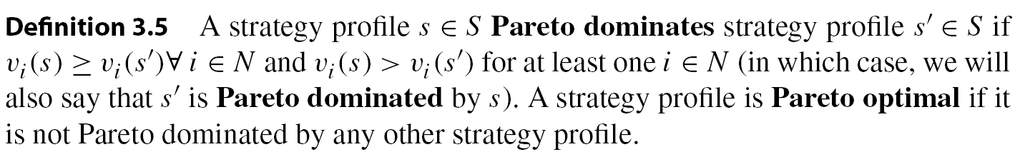
As social scientists, strategic advisers, or policy makers, we hope that players will act in accordance with the Pareto criterion and find ways to coordinate on Pareto optimal outcomes, or avoid those that are Pareto dominated.
However, this result will not be achievable in many games. For example, in the Prisoner’s Dilemma we made the case that (F, F) should be considered as a very likely outcome. In fact, it is the only likely outcome. One can see, however, that it is Pareto dominated by (M, M).
博弈论与信息经济学
北京航空航天大学经济管理学院 崔志伟

Slide 40
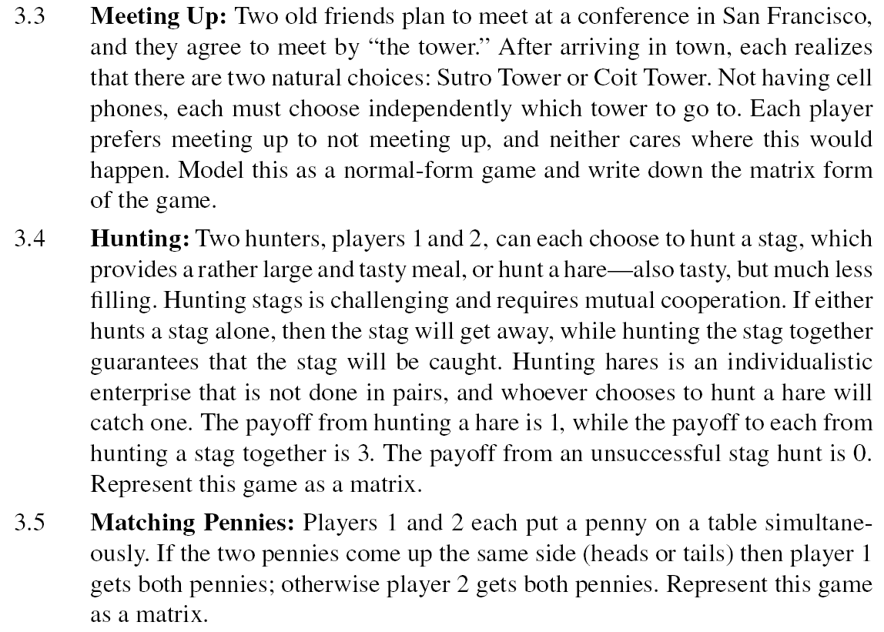
博弈论与信息经济学
北京航空航天大学经济管理学院 崔志伟

